Slide 1
Ignite Talk
Group QuantumBlack
02/17/2022
Notes:
Hi AC297 fellows
I'm Jim from team Quantum Black
Quantumblack, our partner, is a tech consulting firm with strong data science and machine learning background
Today, we are going to give the ignite talk of our project ----
it's about drought prediction powered by machine learning.

Slide 2
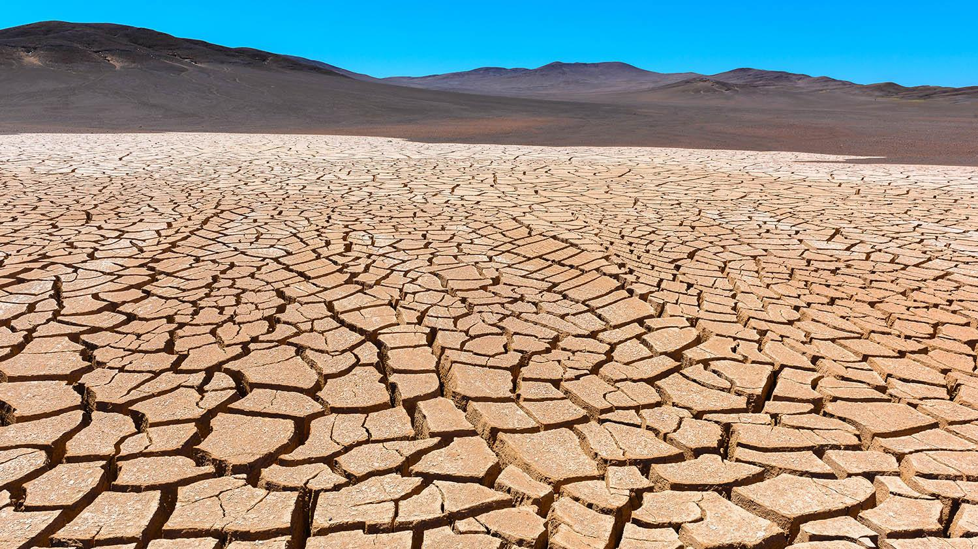
Problem Background:
Drought is an urgent crisis
Drought is a real disaster.
Post-drought aid is inefficient.
Notes:
Drought has become the leading cause of humanitarian disasters;
causing drinking water shortage, wildland fire, loss in crop and livestock
And we must realise that the ultimate cost will be the loss of human lives
(too short, more words/ slowly)

Slide 3
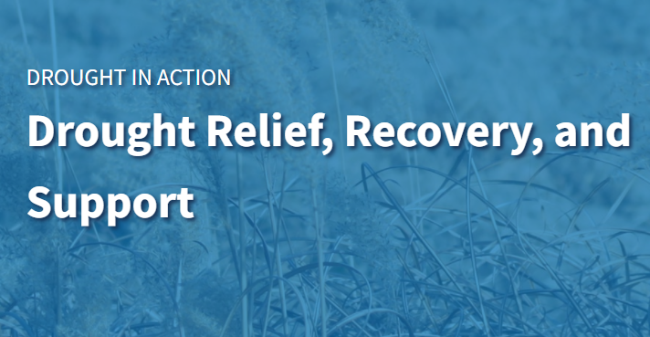
Problem Background:
Drought prediction
Drought prediction is effectively saving lives.
Notes:
However, post-drought aid is time-consuming. Usually when the aid has arrived, i-rreparable damage has already been done.
Being able to predict the droughts relates directly to saving lives and worth the utmost attention from the data science research community.

Slide 4
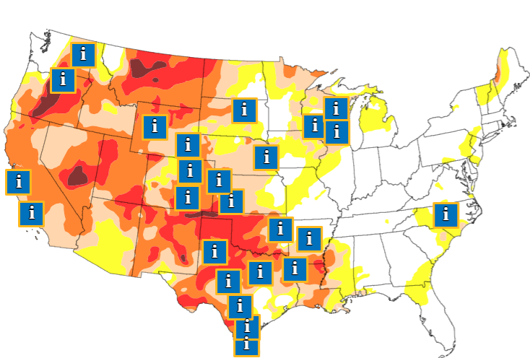
Problem Background:
AI for social good
Drought prediction is a part of AI for social good at QuantumBlack.
Untapped value exists in data.
Notes:
QuantumBlack is particularly interested in AI for social good.
They believe there is untapped value in many data sets;
Currently, we are working with them to create an efficient drought prediction tool
based on open source satellite images and public climate data.

Slide 5
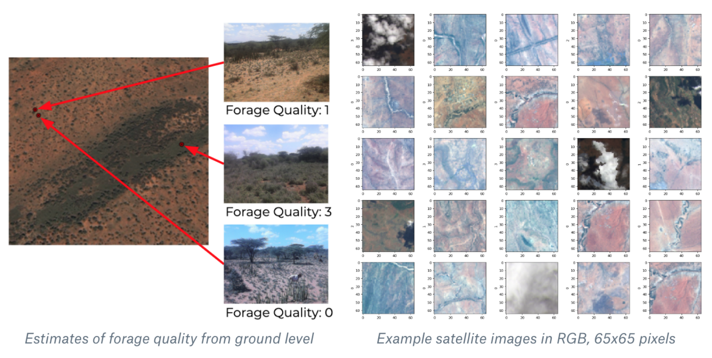
Previous Work
Focused on identifying the areas with high drought risk from satellite images
Source: Satellite-based Prediction of Forage Conditions for Livestock in Northern Kenya
Notes:
Most of the previous work has focused on using satellite images to identify the areas with high drought risk through the use of computer vision. So the focus was on identifying where the problem is at that particular moment. The concern with this is that it doesn’t give much information ahead of time and so organizations/governments might not be able to prepare the resources to react for it or provide support in time.
Nothing much work has been done on estimating the impact of these drought events.

Slide 6
Previous Work
Focused on identifying the areas with high drought risk from satellite images
Does Not Provide Information Ahead of Time!
Source: Satellite-based Prediction of Forage Conditions for Livestock in Northern Kenya
Notes:
Most of the previous work has focused on using satellite images to identify the areas with high drought risk through the use of computer vision. So the focus was on identifying where the problem is at that particular moment. The concern with this is that it doesn’t give much information ahead of time and so organizations/governments might not be able to prepare the resources to react for it or provide support in time.
Nothing much work has been done on estimating the impact of these drought events.

Slide 7
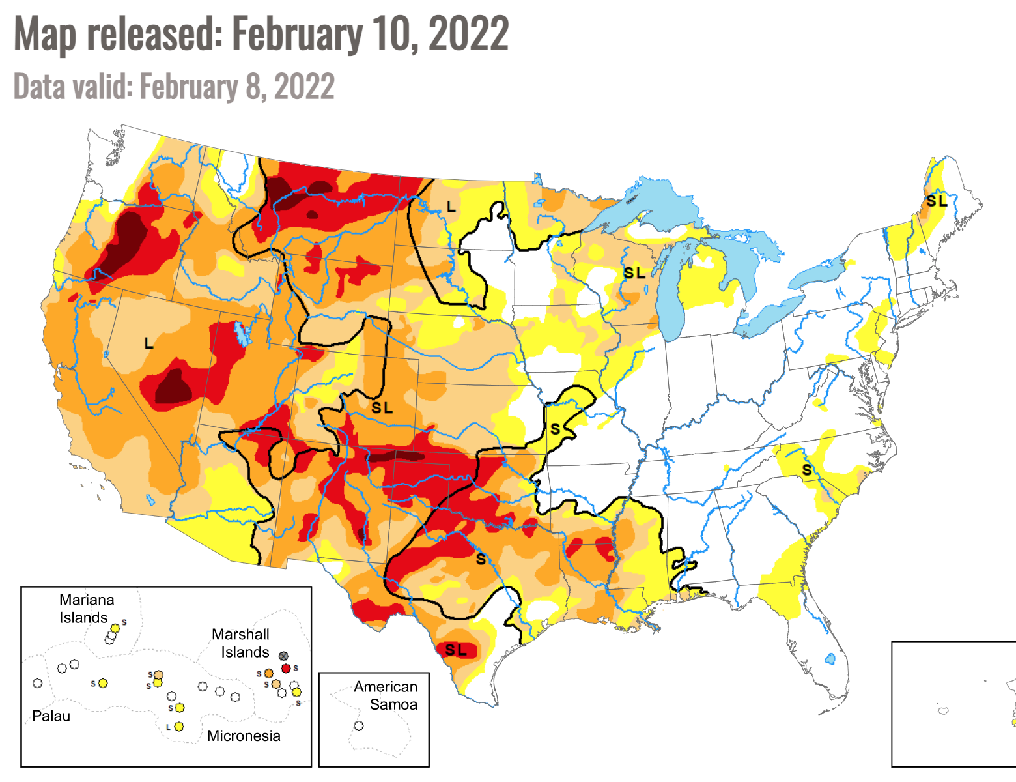
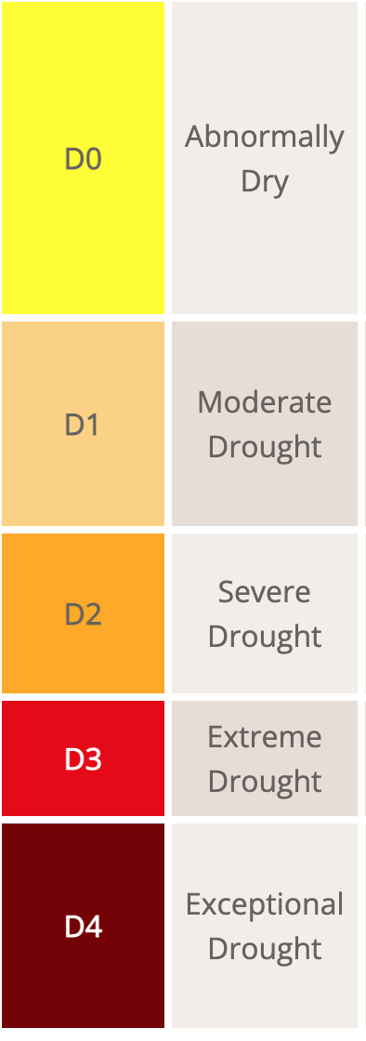
Problem Statement
Predict the drought risk in the U.S. ahead of time
Drought Forecast
Source: US Drought Monitoring
Notes:
So our group tries to look at this topic in a slightly different perspective. We want to predict the drought risk ahead of time in each area in the U.S. So our work will focus on time-series prediction instead of spatial prediction. And also plan to build a model that estimates the impact of the drought on each area that is affected. E.g. How will it affect livestock production, crop yield or crop prices.
All of this so that government can take precautionary measures.

Slide 8
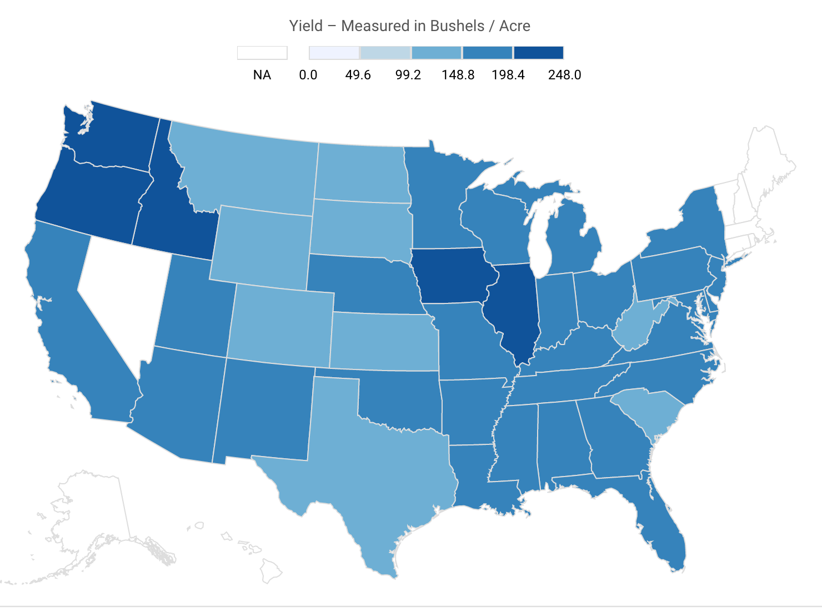
Problem Statement
Predict the drought risk in the U.S. ahead of time
Estimate its impact on economy
Drought Forecast
Its Impact
Source: US Drought Monitoring
Source: United States Department of Agriculture
Notes:
So our group tries to look at this topic in a slightly different perspective. We want to predict the drought risk ahead of time in each area in the U.S. So our work will focus on time-series prediction instead of spatial prediction. And also plan to build a model that estimates the impact of the drought on each area that is affected. E.g. How will it affect livestock production, crop yield or crop prices. We also notice that there is not much previous work on the impact estimation.
All of this so that government can take precautionary measures.

Slide 9
Project Phases
Data Processing
Modeling
Analysis & Extension
Visualization
Notes:
SO our approach will have four phases. First, we need to process data, find a way to concatenate useful data from many data sources. Then, based on some data we can try prediction models.

Slide 10
Project Phases
Data Processing
Modeling
Analysis & Extension
Visualization
Notes:
As modeling goes, the complexity and the problem will also narrow down our dataset usage, like whether we are to incorporate satellite images.

Slide 11
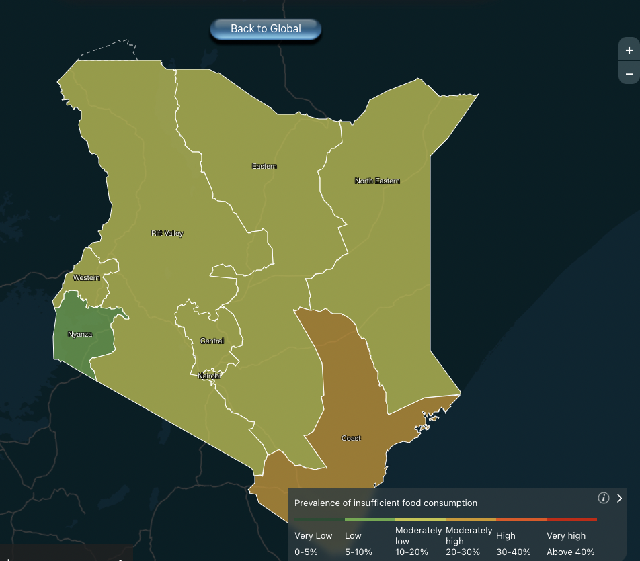
Project Phases
Data Processing
Modeling
Analysis &
Extension
Visualization
Model Choice?
Factor?
Economic Impact?
Notes:
Analysis step includes choosing the prediction model with best performance, figuring out what factor leads to drought the most, and verifying drought’s economic impact, such as increase in regional crop prices
And we hope to use an information dashboard format to show our results

Slide 12
Data Sets: Overview
Predicting Drought
Satellite images via Sentinel and USGS Earth Explorer
Global satellite images from European Space Agency and others
Environmental variables via FAOSTAT and ERA5
Agriculture and natural resource management

Slide 13
Data Sets: Overview
Predicting Drought
Satellite images via Sentinel and USGS Earth Explorer
Global satellite images from European Space Agency and others
Environmental variables via FAOSTAT and ERA5
Agriculture and natural resource management
Climate observation data via USDA ArcGIS, US Drought Monitor, and NOAA Nat. Centers for Env. Information, and SMAP
Drought indices and thresholds
Climate observation data, modeled soil moisture over 1200 years

Slide 14
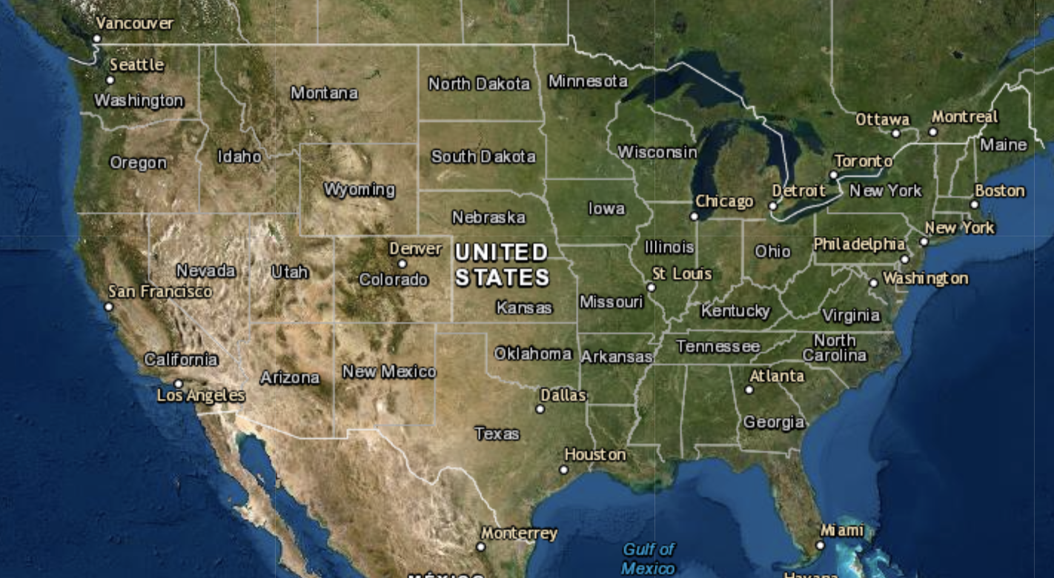
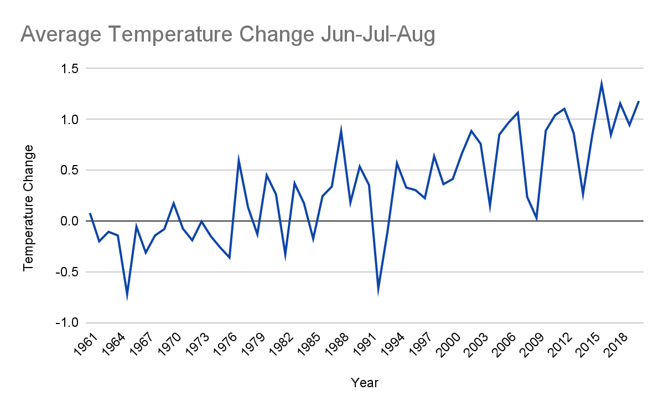
Data Sets: Challenge - Diversity of Data

Slide 15
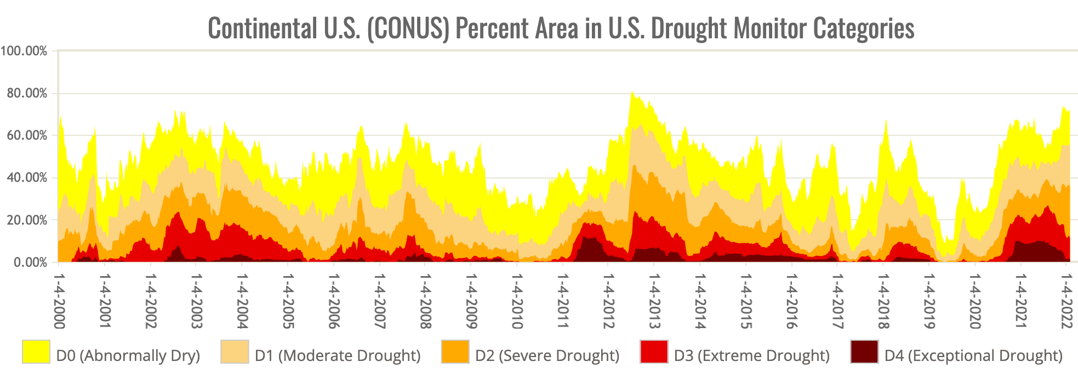
Data Sets: Challenge - Diversity of Data

Slide 16



Conclusion & Future Work
Explore
Utilize
Social Good
Notes:
As a conclusion, we cant wait to explore all datasets that we have, and utilize as much data as we can into effective modeling. We hope to get a meaningful prediction on droughts that fits our purpose： AI for social good！Thank you!

